Slide 1
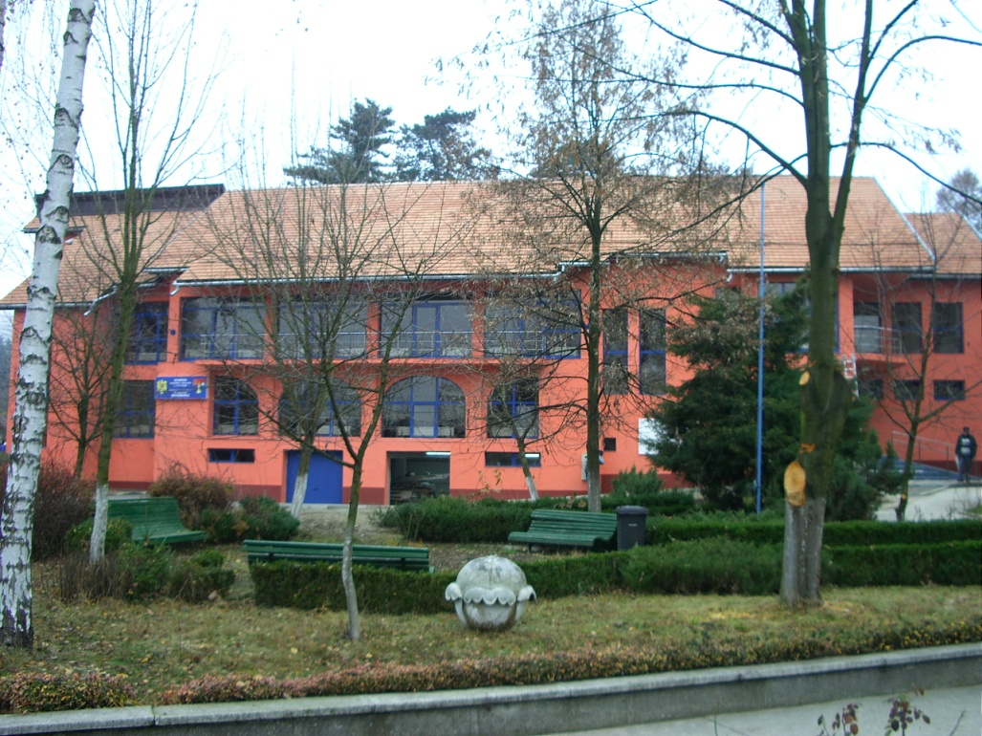
Maramureş County School Inspectorate, Romania

Slide 2
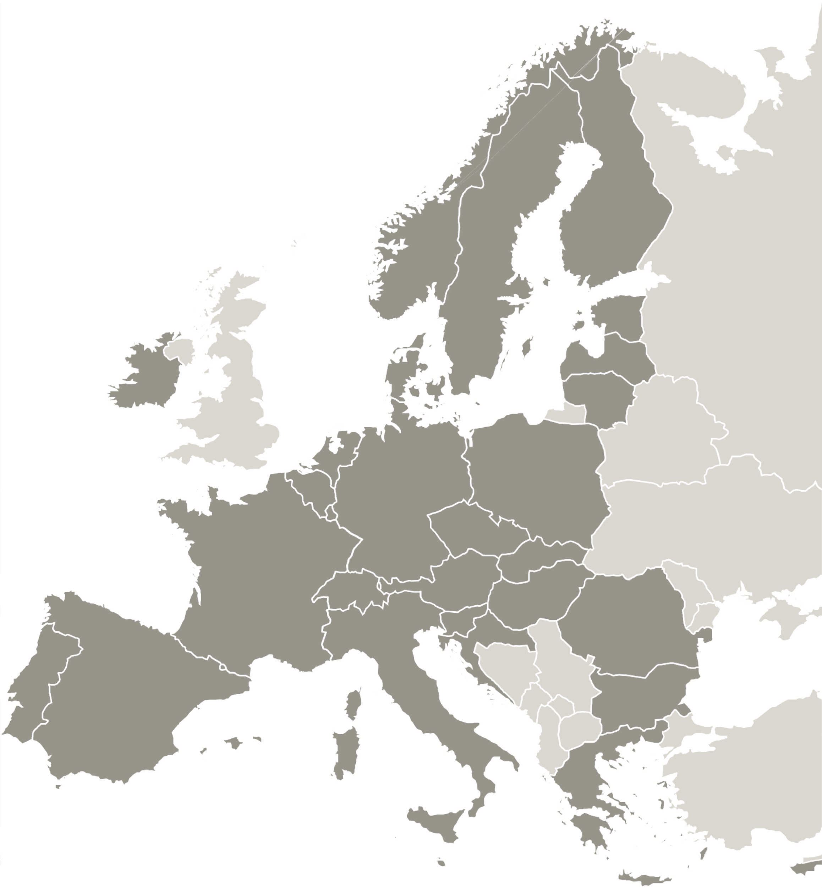
About Maramureș County School Inspectorate
Our institution is a public local body of the Ministry of Education, organized in Maramures County, acting with the purpose of achieving the educational objectives stated in the Law of pre-universitary education.
Its entire activity is based on the Law of pre-universitary education, on Government issued decisions, on all normative documents and methodologies issued by the Ministry of Education.
50 emplyees

Slide 3
Maramureș County School Inspectorate
applies the policies and strategies of the Ministry of Education and Research.
controls, monitors and assesses the quality of school management, ensuring - together with public administrative local bodies - the schooling of pupils, their attendance throughout mandatory education.
supervises law enforcement and monitors
the quality of teaching-learning activities
and the conformity of national and international standards of performance, by means of school inspection.
coordinates the process of admission in
high-school education, the national exams and
the competitions in the schools within Maramureș county.

Slide 4
Our institution has Erasmus+ accreditation, as consortium leader, for mobilities in the field of: school education, adult education, VET education.
For SCH field, all the participating teachers are from the schools located in rural areas.
The most important result of the SCH Erasmus+ accreditation is the number of teachers trained through the Erasmus+ program:

Slide 5
Results:
2020-1-RO01-KA120-SCH-000095318
2021-2022: 11 teachers
2022-2023: 20 teachers
2023-2024: 50 teachers (7 job-shadowing + 43 courses and training)
2024-2025: 49 teachers (8 job-shadowing + 41 courses and training)

Slide 6
Thank you!
Duruș Ligia

